Slide 1

SYSTEM IDENTIFICATION FOR RATE PREDICITON in OIL WELLS
Pedro Henrique Cardoso Paulo
Felipe da Costa Pereira

Slide 2
agenda
- Problem description
- Literature review
- Dataset
- Methods
- Results
- Concluding Remarks
- Future work

Slide 3
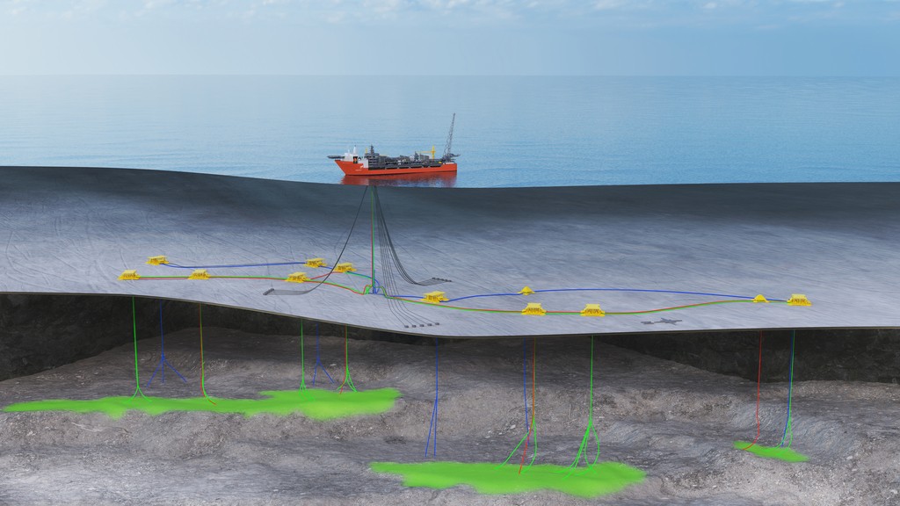
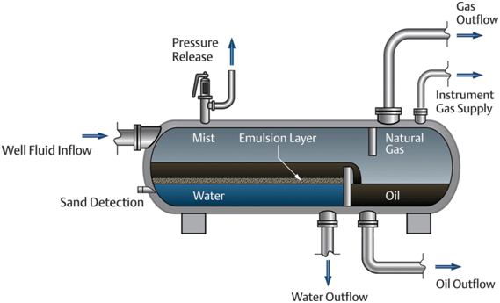
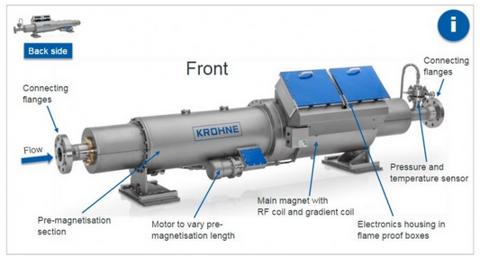
Problem description
[Tracerco.com - Johan Castberg Field, offshore Norway]
Flow rates estimation: Characteristics and Limitations
On a oil and gas production system, the production from each well is uncertain
Well rate is an apportionment of the total production
Measures need to be made after phase separation, one well at a time: test separator
Alternative: multiphase flowmeters
Associated error, calibration is a challenge;
Pressure drop, production loss;
Not accepted by ANP;
One per well, expensive
Impacts
Unreliable production history (3-D simulator input)
Poor capacity to take reservoir management decisions
Offshore Production system
[arab-oil-naturalgas.com]
Multiphase Flowmeter [krohne.com]
3-Phase separator vessel (oil/water/gas)

Slide 4
Literature review RATE PREDICTIONS
Paper | Input | Output | Method | Simulation | Data
Alakeely, Horne [2021] | Surface measures Choke, GOR, WHP | Liquid/Oil rate Water cut | Neural Network, Autoencoders | Free response | Well 15/9-F-14 (Volve)
Jouradanou et al. [2019] | Valves position | Pressures (riser inlet and bottom-hole) | Echo State Network | Free response | OLGA(*)
Aguirre et al. [2017] | Various Process variables | BHP | MLP, NARMAX, NFIR, Kalman filters | Free response | Real wells (Petrobras)
Freitas et al. [2021] | Gas lift Flow Rate | BHP | MLP Steady State response | Free response | 2 simulated systems, 1 Deep water oil well
Apio et al. [2019] | Tubing Pressure Riser Pressure | BHP | Kalman Filters | Free response | 2 OLGA(*) cases 1 real well (Petrobras)
Liu et al. [2022] | No input (auto-regressive) | Oil Rate | ESN + GA | Short term forecast (15%) | 2 China + 1 US oil Fields
(*) OiL and GAs dynamic multiphase flow simulator

Slide 5
Literature review TRANSFORMERS FOR Time series
Pazouki and Farsani (2020) used an adapted version of the architecture in multiple benckmark datasets and obtained better or equivalent results when compared to other methods
Zerveas et al. (2021) proposed a generalistic framework for working with multivariate time series using the architecture
Use unsupervised pre-training of the network in autoregression tasks
Applied the proposed architecture to various time series problems, obtaining better or close results when compared to other methodologies
(*) OiL and GAs dynamic multiphase flow simulator

Slide 6
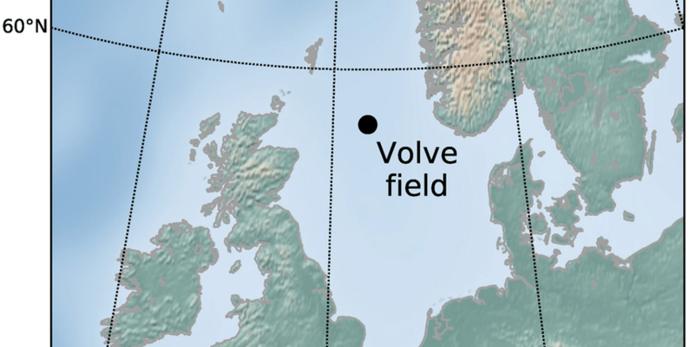
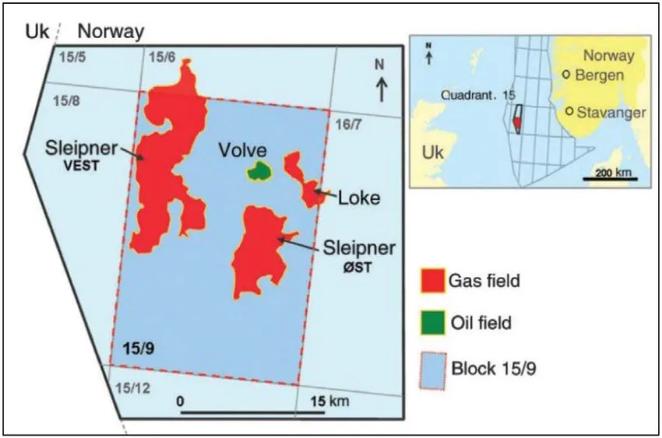
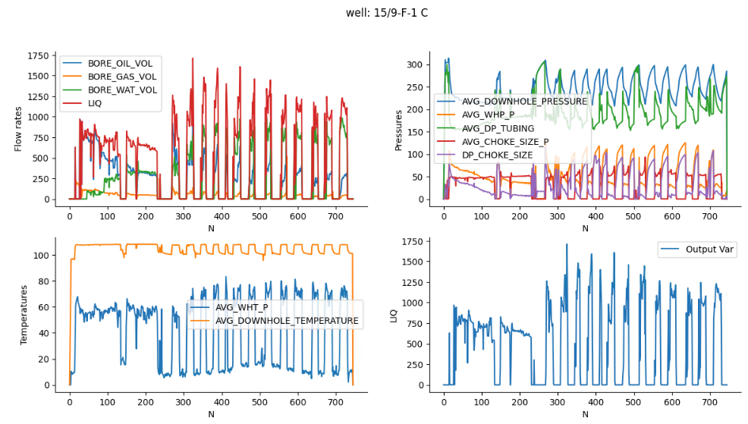
dataset
Dataset Volve Field Data
Volve Field Dataset
Production history, geological data and reservoir model provided by Equinor
Disclosed in 2018 by Equinor
6 production wells + 1 water injector well
Available well data:
Temperature and Pressures
Well head, X-mas Tree and bottomhole
Choke openings and pressure drop
Oil, water and gas rates
www.equinor.com

Slide 7
Methods: Transformer architecture
DL Framework: PyTorch
Input comprised of input variables and output variable, all delayed one timestep from prediction
Both N_{enc} and N_{fc} can be varied (base case is 1 and 0)
Memory comprises the number of vectors provided to the attention mechanism (base case is 16)
Statistical analisys performed
N_{enc} from 1 to 4
N_{fc} from 0 to 2
Memory from 4 to 32
10 runs for each model
Some hyperparameters were kept constant in all performed tests
Dropout kept in 10%
Transformer feedforward dimension kept in 12
Data input (6 x memory)
Transformer Encoder Layer
Linear Layer (6 x 1)
Predicted value (1x memory)
Fully-Connected Layers with ReLU Activation (6 x 6)
Input masking (train only)
N_{enc} layers
N_{fc} layers

Slide 8
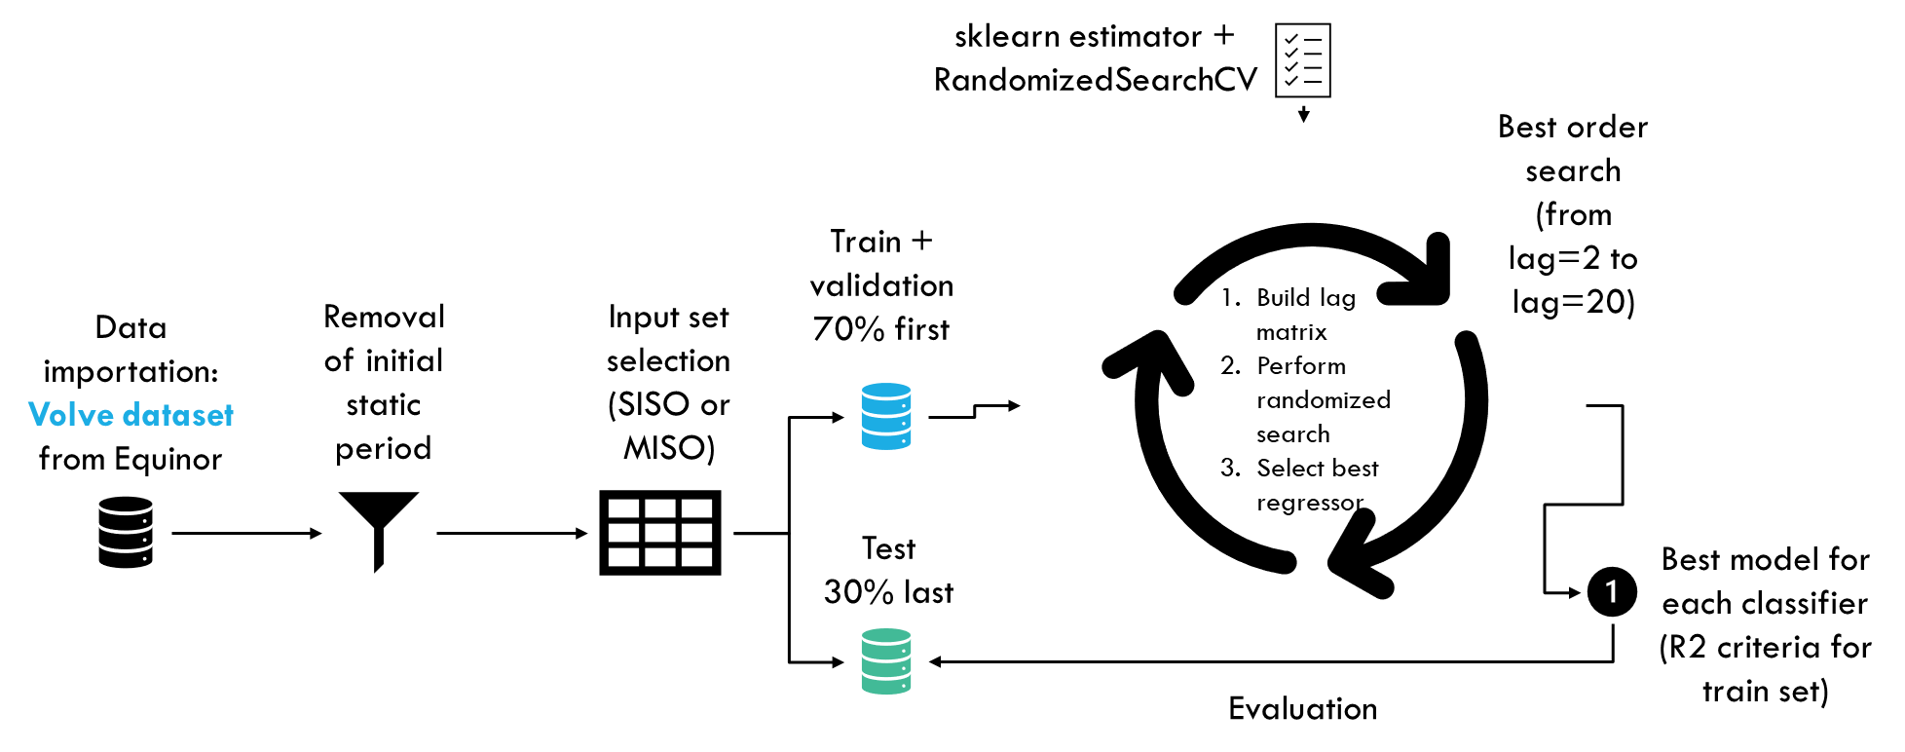
Methods: NUMERICAL EXPERIMENT PIPELINE (SYSID)

Slide 9
Methods: NUMERICAL EXPERIMENT PIPELINE (TRANSFORMER)
Read data
Select input variables
Select output
Normalize data
Divide by q95
Create data windows
Input containing input and output variables of the previous timestep
Consider only train data
Split the data
60% train
10% validation
20% test
Create batches
4 Windows in each batch
Train the network
Optimizer: AdamW
LR: 5 x 10⁻⁴
Patience: 20 epochs
Evaluate model
RMSE
R²
Loss: MSE (considering full window)

Slide 10
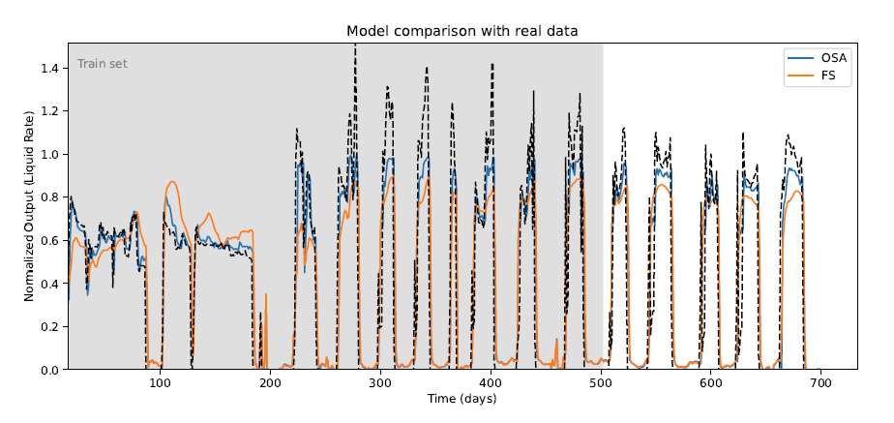
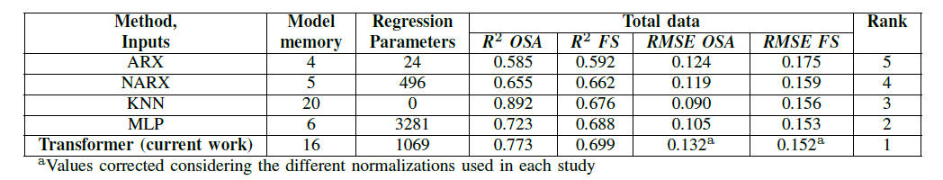
Results Overall results

Slide 11
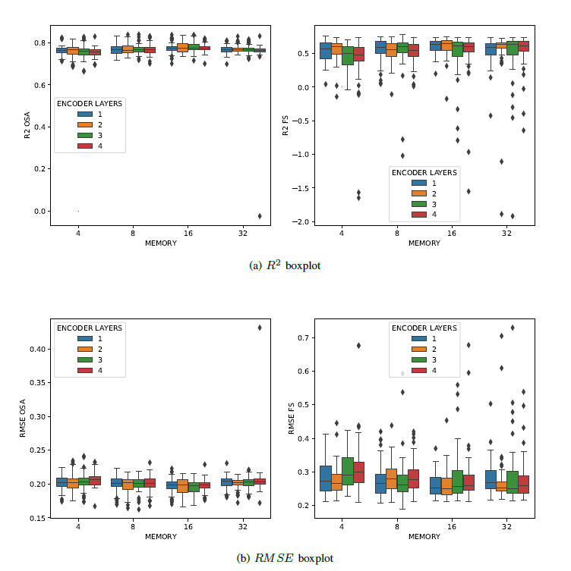
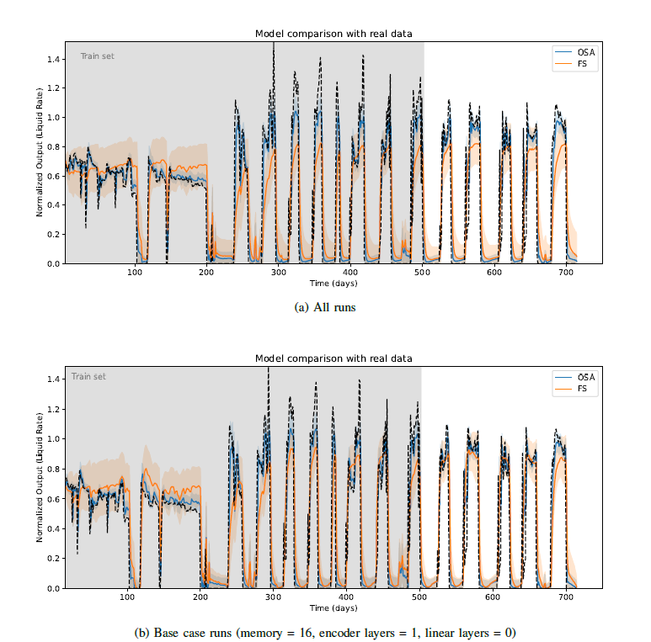
Results statistical analisys

Slide 12
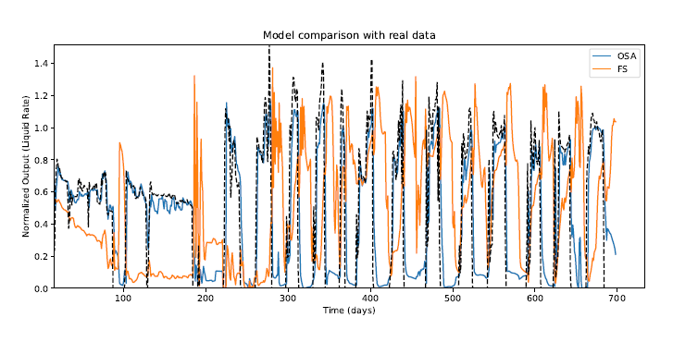
Results TRANSFER LEARNING
No data form the benchmark well seen during training
More encoder layers added due to more data available (4 layers)
Good agreement in OSA prediction, but poor performance in FS
More tests needed

Slide 13
Concluding remarks
Transformer model outperforms the other models considered
Demand less parameters than the FC NN
Valid for the base case model
Statistical analysis showed low impact of the memory window
More encoder layers caused more outliers (maybe we do not have enough data)
Average base model is better than the average tested model
FS standard deviation is very similar in all models and base model
Transfer learning showed promising results in OSA prediction
Poor results in FS
More studies are needed

Slide 14
Future work
Improve the variance of the model, reducing the dispersion
Improve architecture in order to viabilize the transfer learning strategy for Free-run simulations
Work with dimensional data, eliminating the normalization timestep
Include other similar benchmark datasets in the pipeline, such as the SPE Dataset

